Slide 1
How to Deal with CORS?
The Final Solution for Front-end Developers

Slide 2
THE PROBLEM

Slide 3
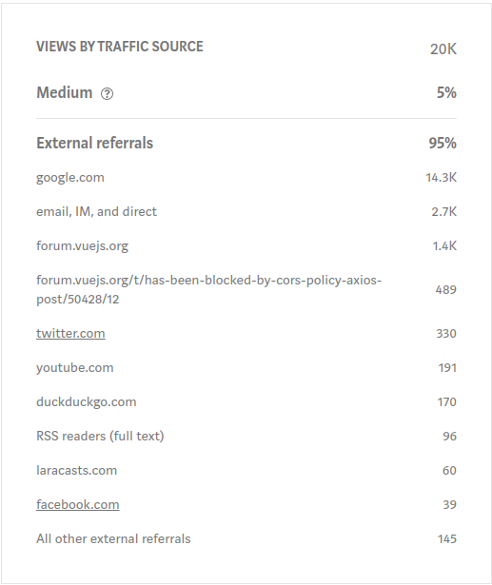
The Problem
14.3K
190
Google Search Referral
Average Daily Reader

Slide 4

The Problem
WE DON'T KNOW CORS.

Slide 5
Same Origin Policy

Slide 6






Same Origin Policy
https://localhost:8080
http://localhost:8081
http://localhost:8080
https://github.com
protocol
host
port
http://localhost:8080/posts

Slide 7
Cross Origin Resource Sharing
(CORS)

Slide 8



Cross Origin Resource Sharing
Server A
Server B
Notes:
Cross-Origin Resource Sharing (CORS) is a mechanism that uses additional HTTP headers to tell a browser to let a web application running at one origin (domain) have permission to access selected resources from a server at a different origin. A web application executes a cross-origin HTTP request when it requests a resource that has a different origin (domain, protocol, or port) than its own origin.

Slide 9
Cross Origin Resource Sharing
Access-Control-Allow-Origin "*"
Access-Control-Allow-Methods "POST, GET, OPTIONS, DELETE, PUT"
Access-Control-Allow-Headers "x-requested-with, Content-Type, authorization"

Slide 10

Cross Origin Resource Sharing
?

Slide 11
Cross Origin Resource Sharing
BROWSER

Slide 12
How does it work?

Slide 13




How does it work?
Client
Browser
Server
http://localhost:8080
http://backend.test
GET “http://backend.test/api/posts”
GET “http://backend.test/api/posts”
Origin http://localhost:8080
Response ...
Access-Control-Allow-Origin "*"
Response ...
Access-Control-Allow-Origin "https://negar.dev"

Slide 14
How does it work?
Client
Browser
Server
http://localhost:8080
http://backend.test
OPTIONS
Origin http://localhost:8080
Access-Control-Request-Method: "DELETE"
Preflight Request
DELETE “http://backend.test/api/1”
Access-Control-Allow-Origin "*"
Access-Control-Allow-Methods "POST, GET"
Access-Control-Allow-Origin "*"
Access-Control-Allow-Methods "POST, GET, DELETE"

Slide 15
Front-end Solutions

Slide 16
Front-end Solutions
Browser Extensions
google-chrome --disable-web-security
Proxy

Slide 17
Proxy

Slide 18
Proxy
// webpack.config.js
module.exports = {
}
devServer: {
}
proxy: 'http://backend.test/',

Slide 19
What Makes It Perfect?

Slide 20
What Makes It Perfect?
Inside the Front-end Layer of App
In the Project Scope
Development Mode Only

Slide 21
Thank You
Negar Jamalifard
http://negar.dev/

